Slide 1

Deep Learning-based Feature Selection for Cancer Genomics
Presented By-
Aditya Jain (CSE, 1903102)
Satvik Bhatnagar (MnC, 1903215)
Supervisor-
Dr. Clint Pazhayidam George
Ms. Akanksha Mishra
School of Mathematics and Computer Sciences (SMCS)
Indian Institute of Technology, Goa
2nd March 2023

Slide 2
Table of Contents
Introduction
Existing Work
Improvements Upon Existing Work
Model Structure
Observations and Results
Scope of Improvement
References

Slide 3
Introduction
The aim of this project is to implement Deep Learning methods like Sparse BNNs and Variational Inference to select essential genes that contribute to the growth of a particular cancer type using publicly available gene expression data.
In Cancer Genomics, the data typically includes information about the genetic mutations, copy number alterations, gene expression levels, and epigenetic modifications in the cancer cells.
Problems
This data is often high-dimensional and noisy, making it challenging to identify the most relevant features or biomarkers that can predict clinical outcomes.
Moreover, gathering the data for cancer-related research is costly, slow, as well as difficult.
The dataset we use has much more features than the number of samples (also called the p (Predictors) >>n (Samples) case).
This calls for specialized data preparation and modeling algorithms to address them correctly.

Slide 4
Existing Work
In the paper by Jincheng Bai, titled “Efficient Variational Inference for Sparse Deep Learning with Theoretical Guarantee”, they train sparse deep neural networks with a fully Bayesian treatment under spike-and-slab priors, and develop a set of computationally efficient variational inferences via continuous relaxation of Bernoulli distribution. We have used the model mentioned in this paper in order to suit our purpose, which is mainly ___.
This Sparse BNN model leverages a sparsity prior on weights to reduce the number of parameters needed to represent the model. The sparsity prior encourages many of the weights to be exactly zero, resulting in a more interpretable and compact model. Variational inference is utilized to approximate the posterior distribution over the weights of the neural network. The model also includes a reparameterization trick to enhance the efficiency of gradient computations during training.
Notes:
This sparse approximation approach is particularly useful when dealing with high-dimensional data, where the reduction in the number of parameters not only reduces computational overhead but also mitigates overfitting and improves generalization.

Slide 5
Improvements Upon Existing Work
The original model was designed for regression, but we modified it significantly for classification by adjusting the loss function and overall architecture.
We fine-tuned the hyperparameters, such as batch size, number of epochs, and layer width, to ensure the model aligned perfectly with the dataset characteristics and achieved optimal performance.
Our model's goal was to extract important features for predicting the given class, so we incorporated a feature selection component.
To improve the model's efficiency and effectiveness, we added a new class with a spike and slab prior assigned to the initial layer while keeping the other layers normal.

Slide 6
Model Structures
Sparse BNN Model Architecture:
Input
Spike And Slab Layer
Spike And Slab Layer
Spike And Slab Layer
Spike And Slab Layer
Feature Selection Model Architecture:
Input
Spike And Slab Layer
Normal Layer
Normal Layer
Normal Layer
Loss Function:
Notes:
The spike-and-slab prior is a statistical model that is commonly used in Bayesian regression analysis to incorporate variable selection.
The spike-and-slab prior is particularly useful in situations where there are many predictor variables, and only a few of them are expected to have a significant effect on the outcome variable. The prior helps to identify the most relevant variables, while also allowing for the possibility that some of the non-relevant variables may still have a small effect.
A normal prior, also known as a Gaussian prior, is a common prior distribution used in Bayesian analysis.
using a normal prior in a layer of a Bayesian neural network can help to regularize the model, reduce overfitting, and provide a measure of uncertainty associated with the weights and biases.

Slide 7

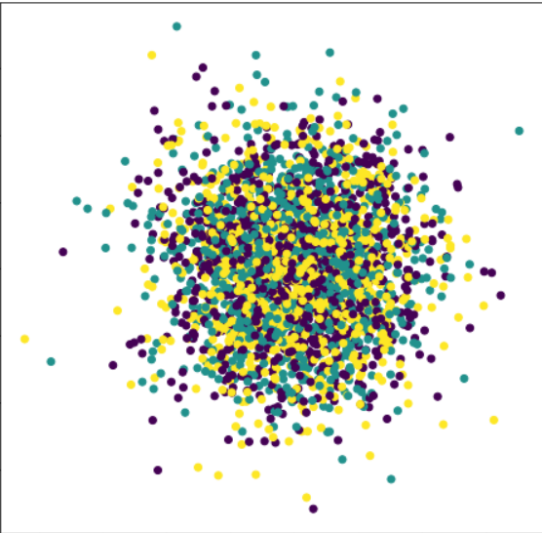
Synthetic Dataset
We did the testing of our current models based on Sparse BNNs and Feature Selection using various plots and metrics on two different kinds of data; one was Two Moon dataset with some random noise, and second was Random data with few important features.
Two-Moon Dataset
Random Data

Slide 8
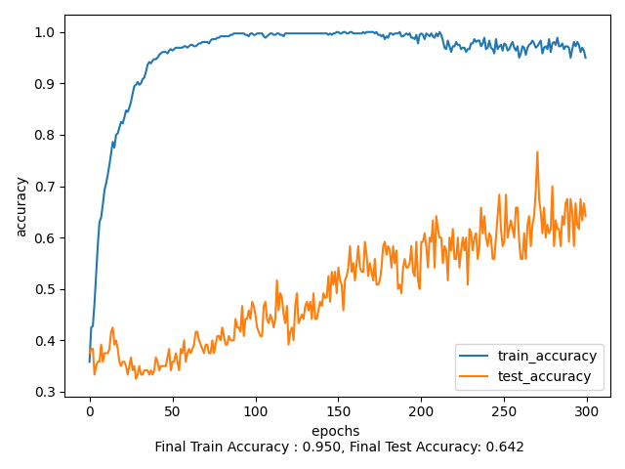
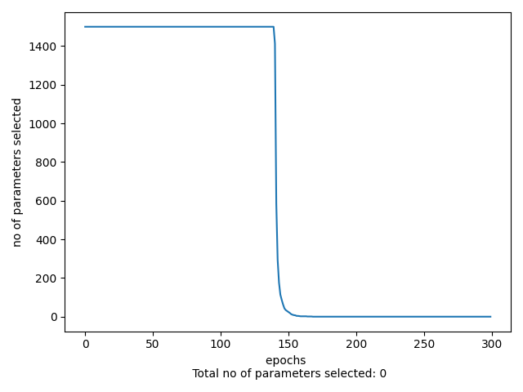
Results- Random Dataset
(using Sparse BNN class)
Sample Size = 360

Slide 9
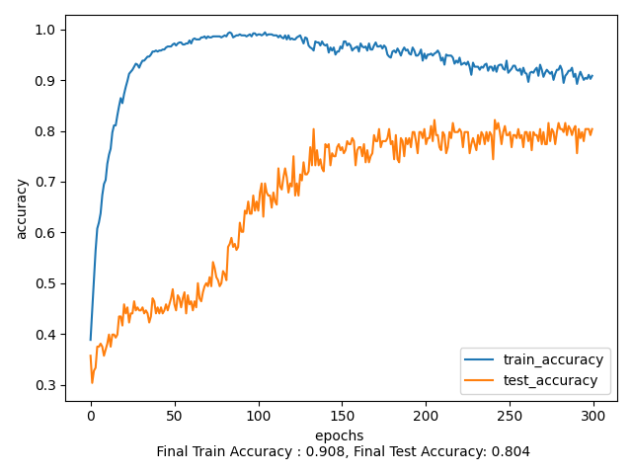
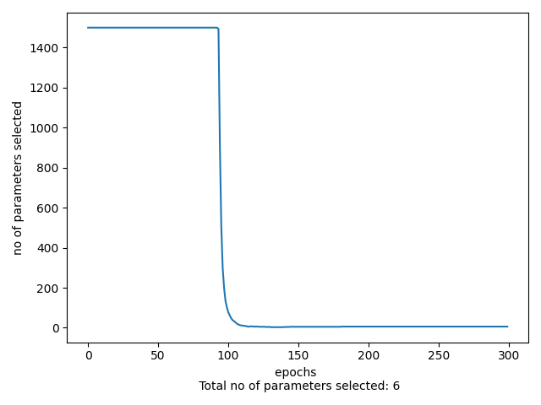
Results- Random Dataset
(using Sparse BNN class)
Sample Size = 500

Slide 10
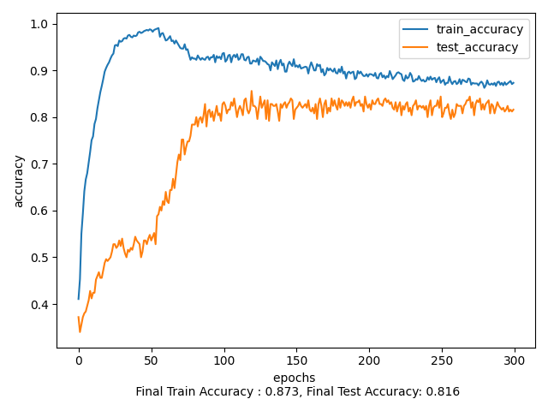
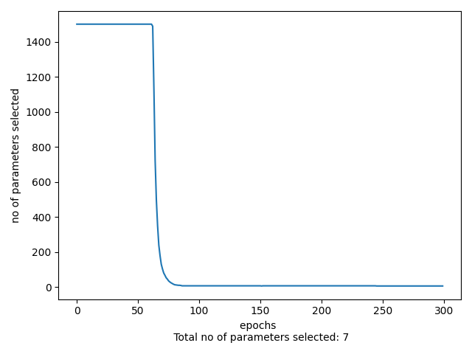
Results- Random Dataset
(using Sparse BNN class)
Sample Size = 750

Slide 11
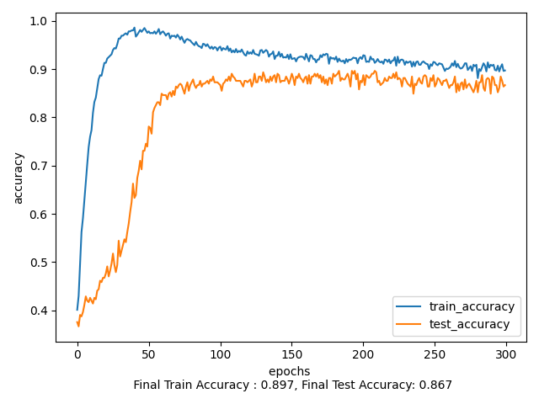
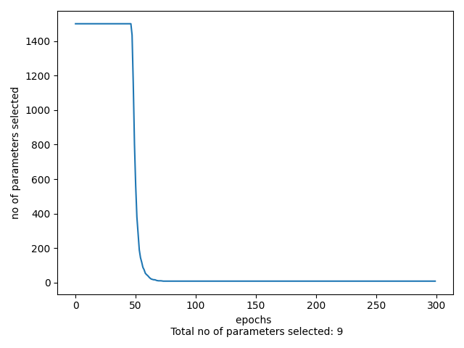
Results- Random Dataset
(using Sparse BNN class)
Sample Size = 1000

Slide 12
Observations and Results
Sparse BNN on Synthetic Dataset
S. No | Data Size | Dimensions | Testing Accuracy | No Of Features Selected
1 | 360 | 1500 | 0.642 | 0
2 | 500 | 1500 | 0.804 | 6
3 | 750 | 1500 | 0.816 | 7
4 | 1000 | 1500 | 0.867 | 9

Slide 13
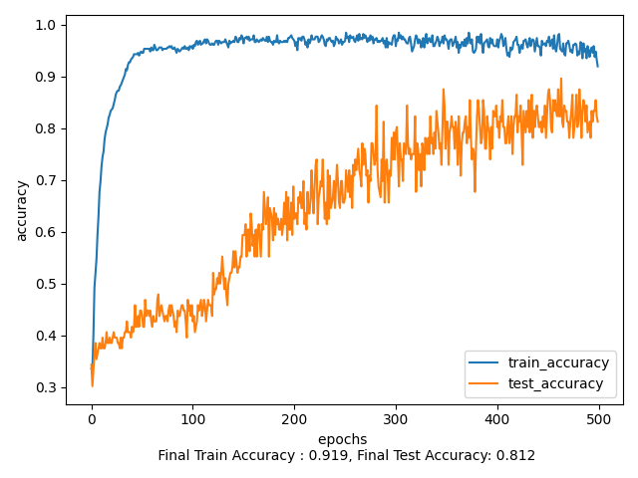
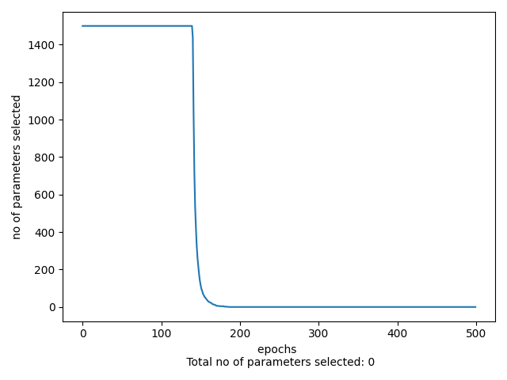
Results- Random Dataset
(using Feature Selection class)
Sample Size = 360

Slide 14
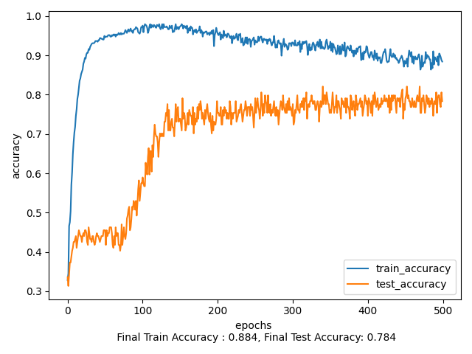

Results- Random Dataset
(using Feature Selection class)
Sample Size = 500

Slide 15
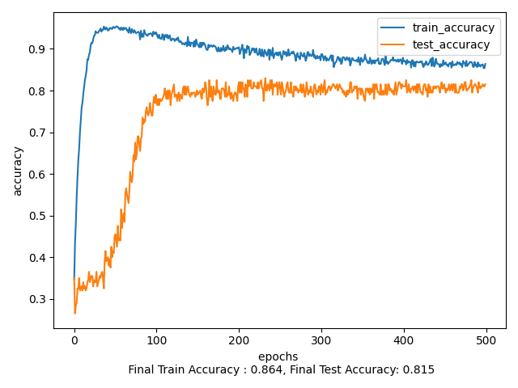
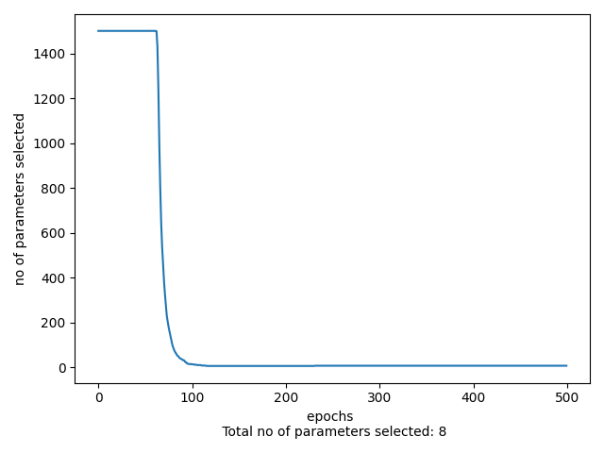
Results- Random Dataset
(using Feature Selection class)
Sample Size = 750

Slide 16
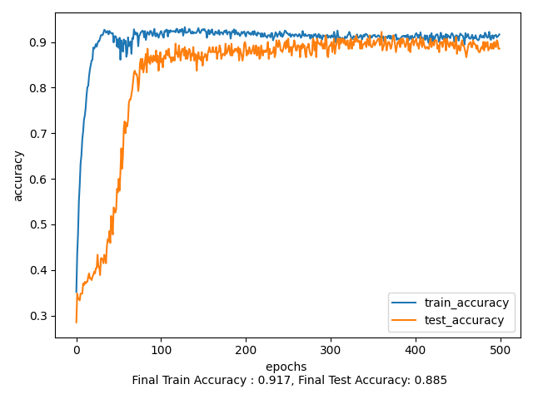
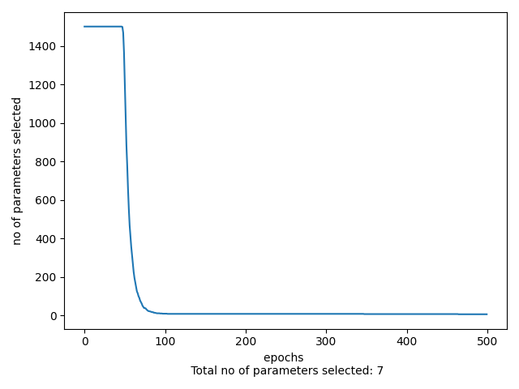
Results- Random Dataset
(using Feature Selection class)
Sample Size = 1000

Slide 17
Observations and Results
Feature Selection on Synthetic Dataset
S. No | Data Size | Dimensions | Testing Accuracy | No Of Features Selected
1 | 360 | 1500 | 0.812 | 0
2 | 500 | 1500 | 0.784 | 4
3 | 750 | 1500 | 0.815 | 8
4 | 1000 | 1500 | 0.885 | 7

Slide 18
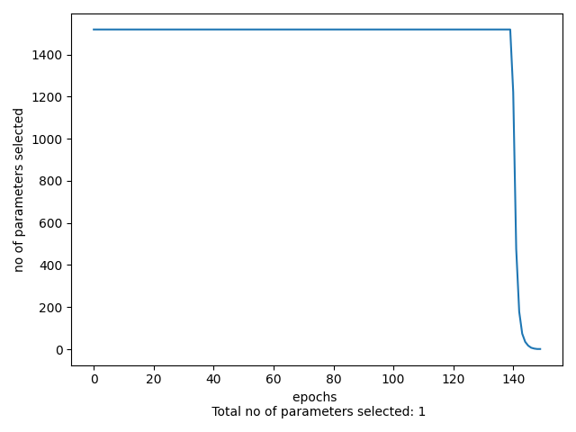
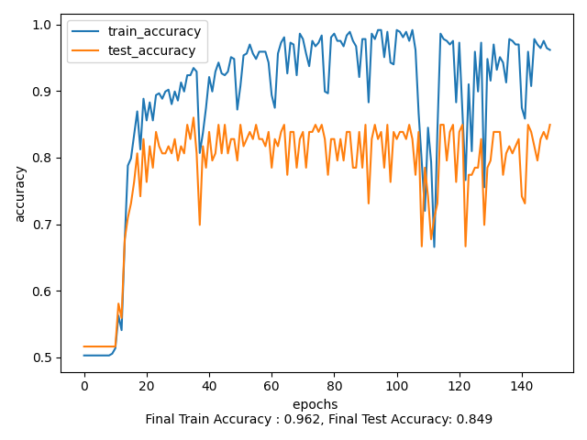
Observations and Results
Feature Selection on Breast Cancer Dataset (BRCA)

Slide 19
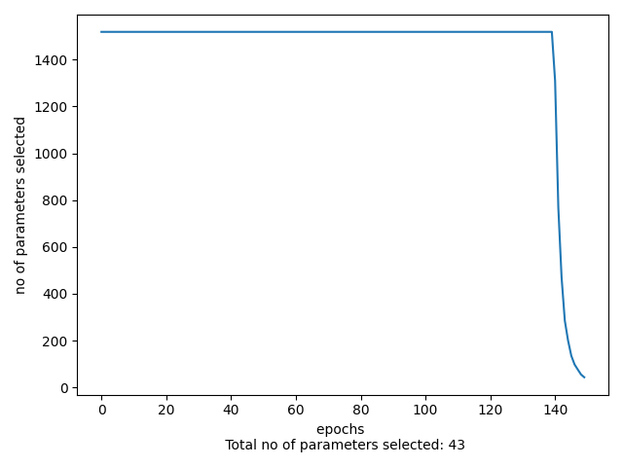
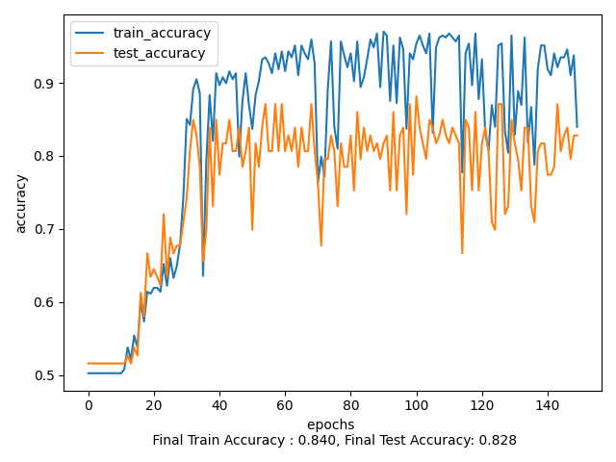
Observations and Results
Sparse BNN on Breast Cancer Dataset (BRCA)

Slide 20
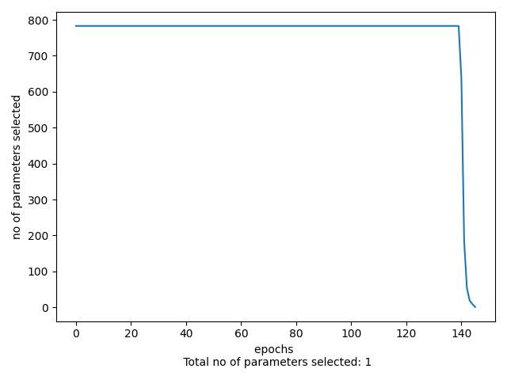
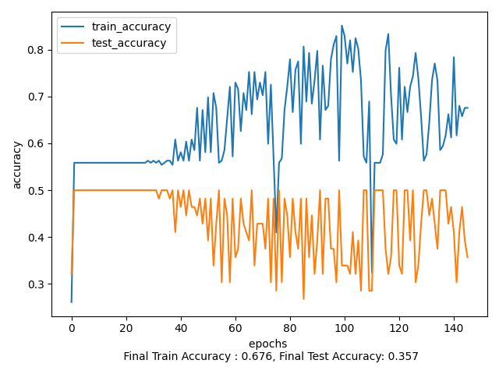
Observations and Results
Feature Selection on Prostate Cancer Dataset (PRAD)

Slide 21
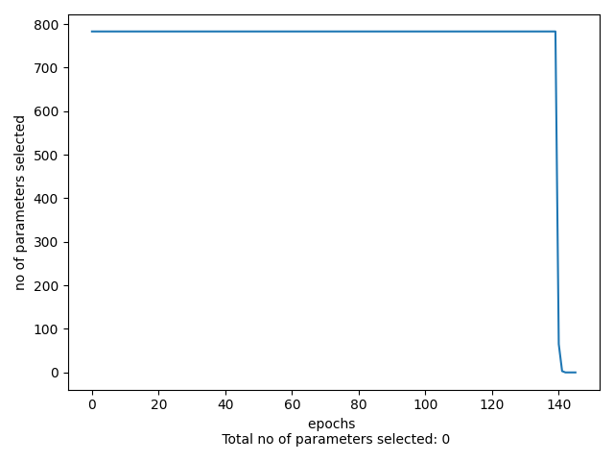
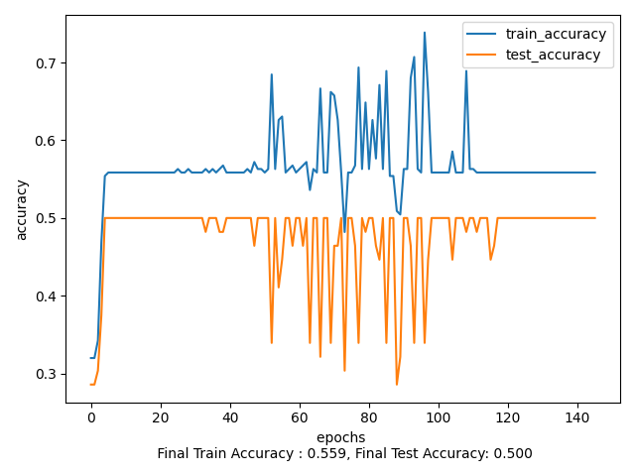
Observations and Results
Sparse BNN on Prostate Cancer Dataset (PRAD)

Slide 22
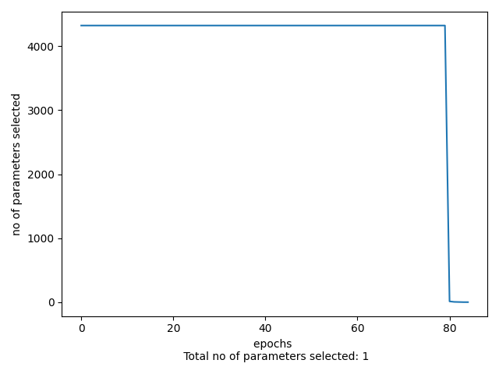
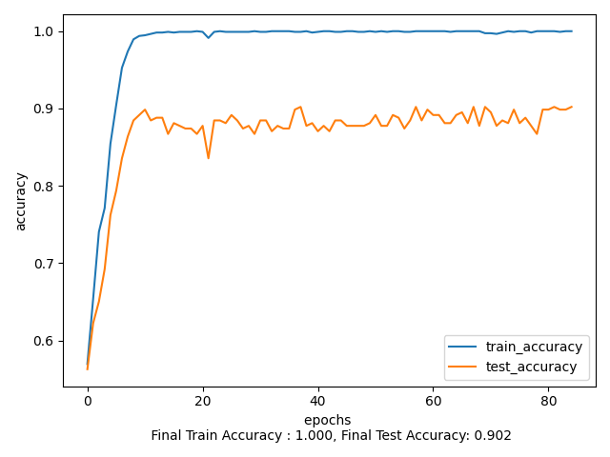
Observations and Results
Feature Selection on STG Dataset

Slide 23

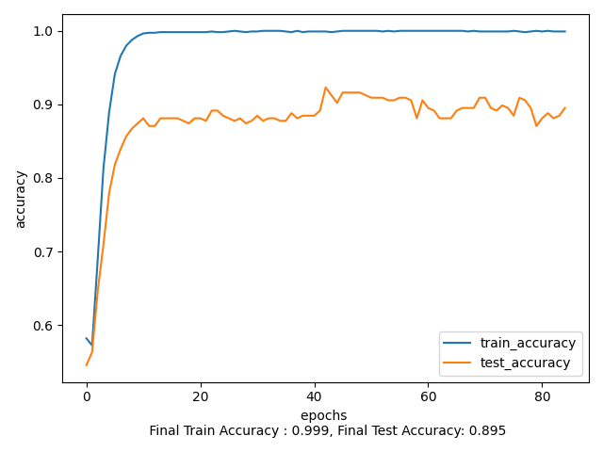
Observations and Results
Sparse BNN on STG Dataset

Slide 24
Scope of Improvement
Understanding the concepts and techniques in the Auto-Encoding Variational Bayes paper like SGVB (Stochastic Gradient Variational Bayes) & Auto-Encoding VB (AEVB) algorithm, and implement them to further enhance the model, if applicable.
Optimizing the model algorithm further by-
Changing the Initialization
Changing the Loss Function
Changing the Model Structure

Slide 25
References
Data:
Genomic Data Commons (GDC) Data Portal by National Cancer Institute (USA)
Stochastic Gates
Papers:
Efficient Variational Inference for Sparse Deep Learning
Auto-Encoding Variational Bayes
An Introduction to Variational Inference
Learning:
Pytorch
Bayesian Statistics
Gumbel Softmax
Spike and Slab Priors
Why Bayesian Neural Networks?
Categorical Reparameterization

Slide 26
Thank You!

